Slide 1
Community and Key Player Detection in Asian Airplane Routes
Ang Wei Hao Max - A0178278L
Bharat Nagaraju - A0178258N
Khine Zin Win - A0163222U
Koo Chee Kit - A0178200N
Li Xiaoguang - A0178450B
Lin JunLiang - A0178295M

Slide 2
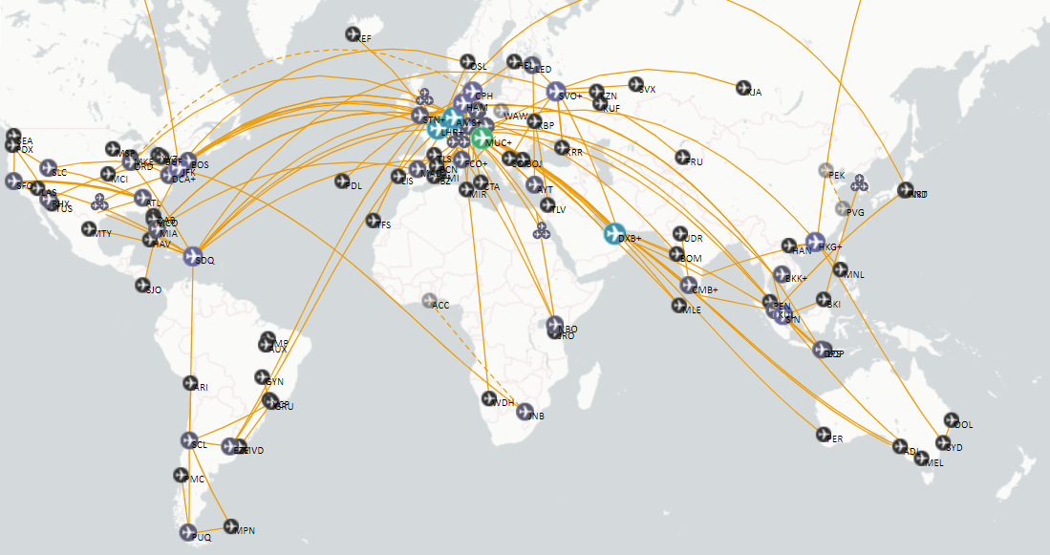
Introduction
building a world logistics and tourism center
better logistics infrastructure
strategic planning for airports’ future developments
decision making process for local governments
Notes:
International airport is an indispensable hardware facility in any commercial metropolis or tourist city in the world. It is a key factor for local government in building a world logistics and tourism center.
This analysis is to detect the communities in the given network. That is, a subgroup in this network includes a set of airports that has a relatively large number of internal ties, and also relatively few ties from the group to other parts of the network. The benefit of the finding is conducive for the airport belonging governments to work closely together to form international corporations for building better logistics infrastructure. It also supports strategic planning for airports’ future developments.
Furthermore, this analysis is to discover the predominant actors in the communities, which play important role in the local network. The key players who have high centrality have bigger chances to become the future stars to handle great passenger volume and cargo flow like Singapore. It is very meaningful in the decision making process for local governments, especially in sense of business and investment.
Data Source: https://openflights.org/

Slide 3
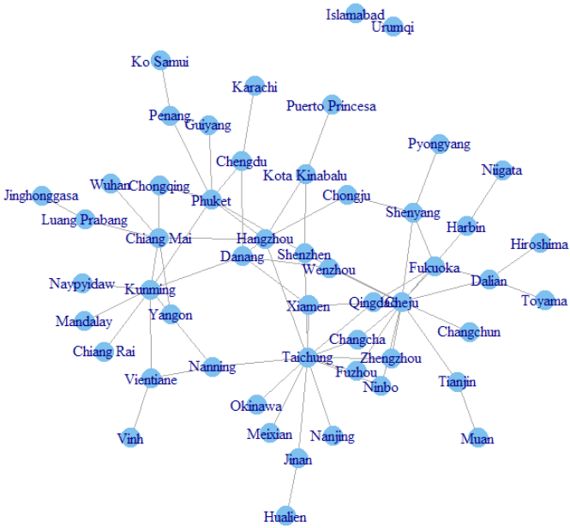
Asian Countries : Intro
52 airports in 12 Asian Countries
Burma
China
Japan
Laos
Malaysia
North Korea
Pakistan
Philippines
South Korea
Taiwan
Thailand
Vietnam
Notes:
This project utilizes the airline routes data for second tier airport web analysis. It looks at the potentials and tries to discover the future predominance in the regional airline network in Asian counties.
The project team purposely excludes developed regional air hubs and heavy traffic airports such as Singapore, Hong Kong and Shanghai etc. It specifically looks at the medium size and small airports, which have less than fifty international routes connecting the region.
52 airports with 172 pair flights in 12 Asian counties (Burma, China, Japan, Laos, Malaysia, North Korea, Pakistan, Philippines, South Korea, Taiwan, Thailand, and Vietnam) form the base data. Each of the airports has bilateral flights with its peer city. So it is non-directed connections linking the airports in the base data.

Slide 4
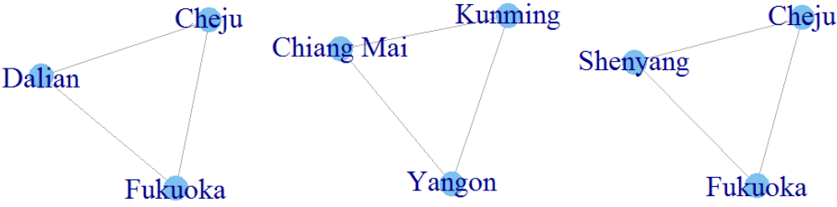
Asian Countries: Community Detection
Algorithm
Clique
Walktrap
Leading eigenvector
greedy optimization
Notes:
Clique is a maximally complete subgraph
Walktrap is a bottom-up approach that split the graph according to random walks
Leading eigenvalue is a top-down approach that split the graph according to modularity
Greedy optimization of modularity is Quite similar to the Walktrap
Edge betweeness measures the shortest path between nodes, gradually removing edge with high betweeness scores and removing the one with the highest score

Slide 5
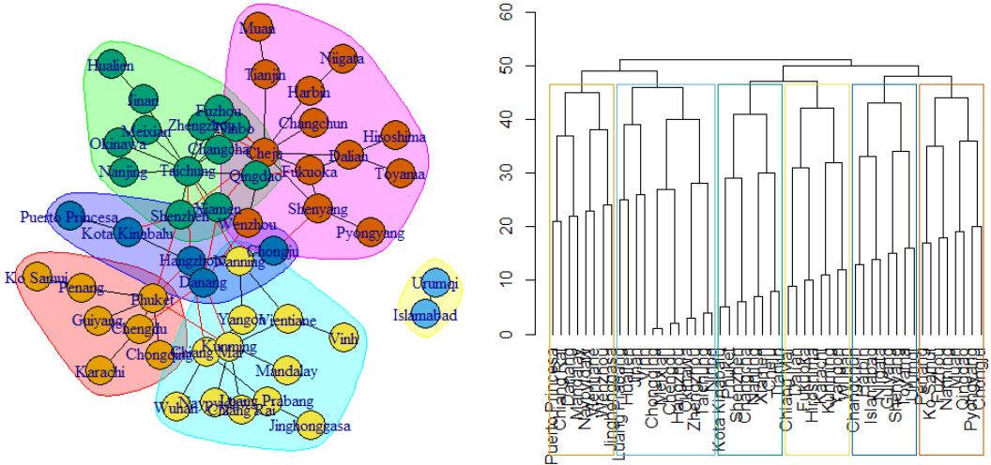
Asian Countries: Algorithm Evaluation
Notes:
Presenter: Ned
R can produce modularity score from each algorithm. When putting the modularity scores together from the 3 algorithms, we can see the difference. Even though the difference between the Leading.eigenvector to greedy optimization is not very obvious, it suggests that the Leading.eigenvector algorithm has done a better job at detecting subgroup structure.
For illustration of the discovery of communities, the results are plotted in two different formats.
Identifying the key players in the communities, the team uses the results from the Leading.eigenvector community detection algorithm.
Taichung, Cheju and Kunming are found as stop players from the top 3 communities.

Slide 6
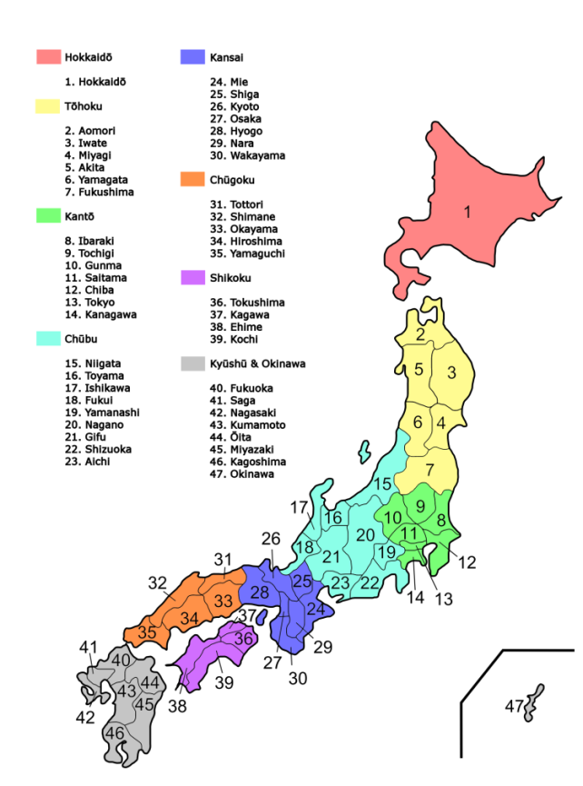
Japan Domestic Airports : Intro
Notes:
Based on directed community (Figure 4), there is a clear indication of pointing towards the bigger airports by the others in the region.

Slide 7
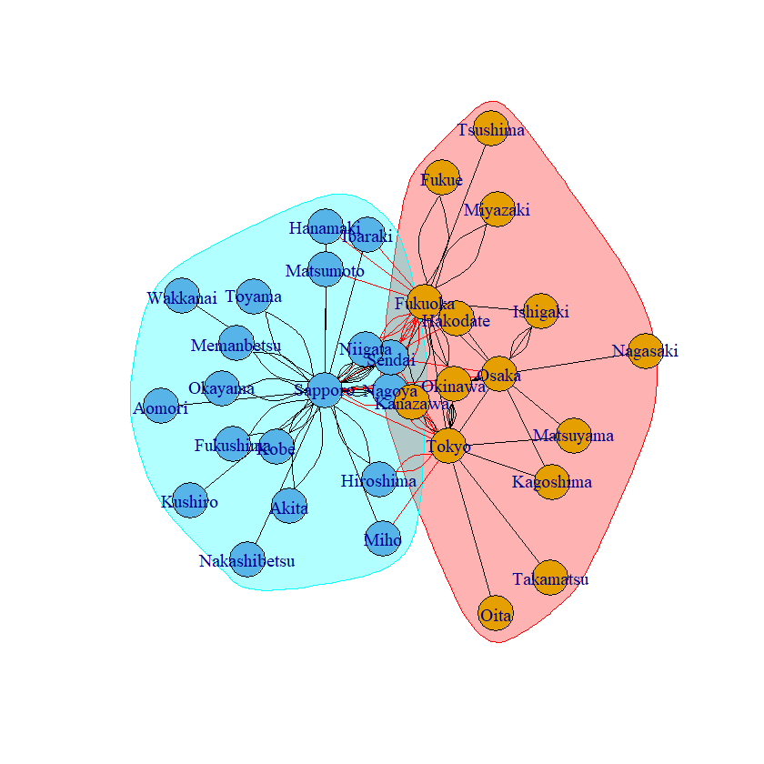
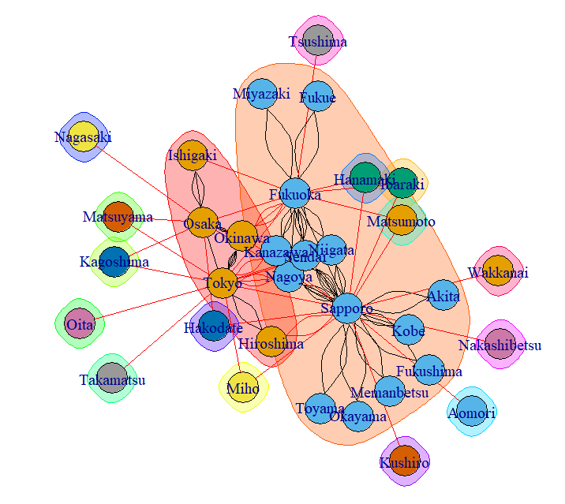
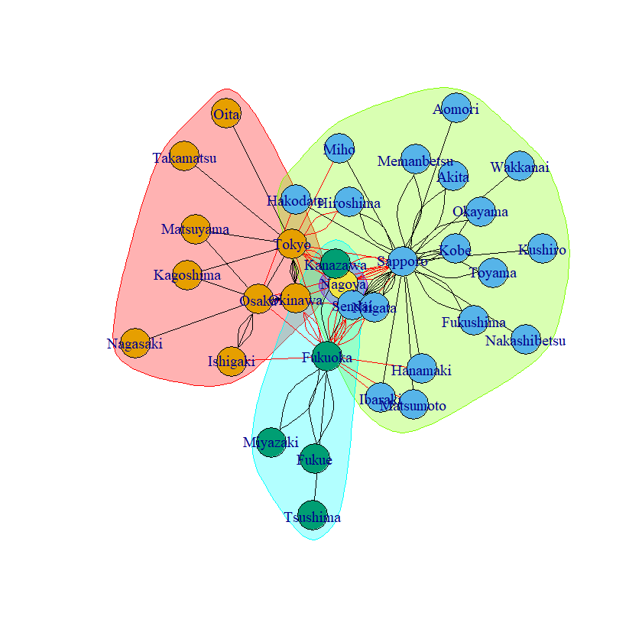
Japan Domestic Airports : Community Detection
Walktrap Plot by 5 busiest airport
Edge Betweeness Plot by 5 busiest airport
Leading Eigenvalue Plot by 5 busiest airport
Notes:
Clique is a maximally complete subgraph
Walktrap is a bottom-up approach that split the graph according to random walks
Leading eigenvalue is a top-down approach that split the graph according to modularity
Greedy optimization of modularity is Quite similar to the Walktrap
Edge betweeness measures the shortest path between nodes, gradually removing edge with high betweeness scores and removing the one with the highest score

Slide 8
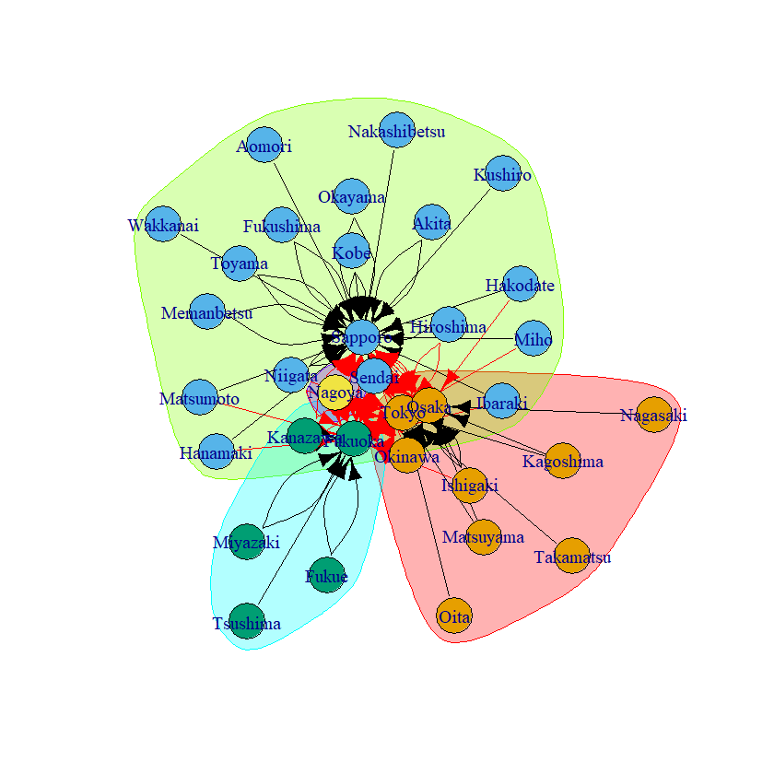
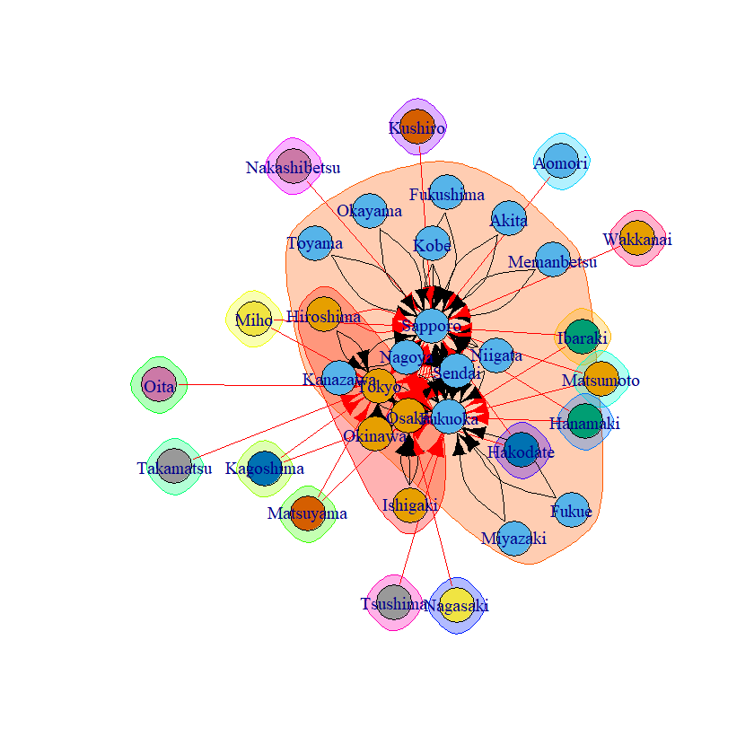
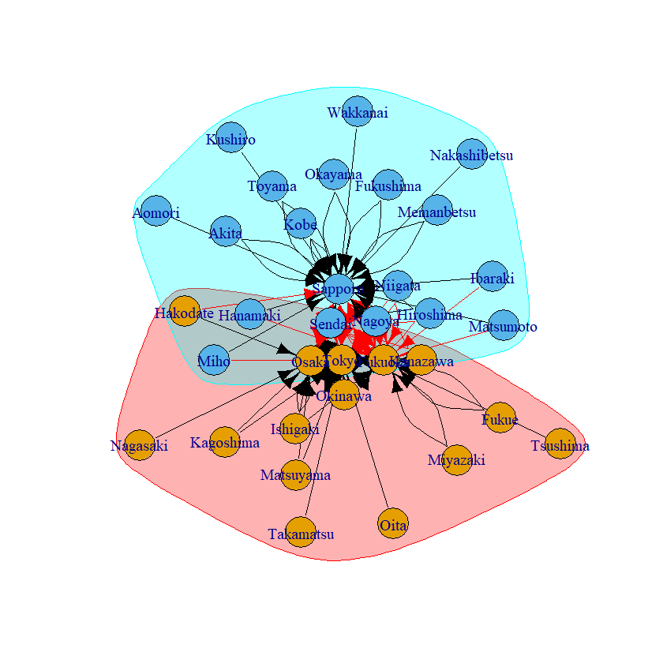
Japan Domestic Airports : Community Detection
Leading.eigenvector (Directed)
Cluster_Edge_Betweeness (Directed)
Walktrap (Directed)
Notes:
Clique is a maximally complete subgraph
Walktrap is a bottom-up approach that split the graph according to random walks
Leading eigenvalue is a top-down approach that split the graph according to modularity
Greedy optimization of modularity is Quite similar to the Walktrap
Edge betweeness measures the shortest path between nodes, gradually removing edge with high betweeness scores and removing the one with the highest score

Slide 9
Japan Domestic Airports : Algorithm Evaluation
Modularity Evaluation - Community
Walktrap.community | 0.09726697
Leading.eigenvector.community | 0.2587694
Cluster_edge_betweeness | 0
Clique Evaluation – Key Player
[[1]]
+ 5/34 vertices, named, from efa8f46:
[1] Sapporo Fukuoka Tokyo Osaka Sendai
[[2]]
+ 5/34 vertices, named, from efa8f46:
[1] Sapporo Fukuoka Tokyo Osaka Okinawa
Notes:
Presenter: Max
Japan’s busiest airports’ location (Tokyo, Osaka, Fukuoka and Sapporo) are central and are generally nodes with more links. The algorithms differ in their categorization of cluster and overlaps. However, there is no clear representation of the clusters.
Walktrap and leading.eigenvalue identify clusters that includes destination out of Japan as well, although leading.eigenvalue manages to capture only Japan’s region in its second cluster. Based on directed community (Figure 4), there is a clear indication of pointing towards the bigger airports by the others in the region.
Modularity is a measure of cluster bond to each other. From the scores above, it is evident that leading.eigenvalue has the highest modularity and cluster_edge_betweeness having the least. This can be seen in the graphs above.
Cliques Evaluation
Largest clique can be found in the following results. Maximum clique stands at 5 and include the major cities in Japan. Sapporo, Fukuoka, Tokyo, Osaka, Sendai and Okinawa are the key player with centrality.

Slide 10

Conclusion and discussion
local civil aviation policy
strengthen corporations amongst the airports
regional economy
Notes:
to re-adjust the local civil aviation policy for future developments. Members sit together in the same community, shall eye on and strengthen corporations amongst the airports. The goal is to grow together to a mega international airport alliance to push regional economy.
achieve win-win situation, for example 2 airports in Taiwan, 1 in Japan and the rest in China in the group of Changcha, Fuzhou, Hualien, Jinan, Meixian, Nanjing, Ninbo, Okinawa, Qingdao, Shenzhen, Taichung, Xiamen and Zhengzhou.
For Japan domestic air industries, it can be observed that flights routes in Japan will be centralise towards the major cities in Japan. This is evident from the directed routes towards the centre of all three graphs.

Slide 11
Q & A

